Slide 1
Node js Streams
Anju Munoth

Slide 2
Streams
Collections of data — just like arrays or strings.
The difference is that streams might not be available all at once, and they don’t have to fit in memory.
This makes streams really powerful when working with large amounts of data, or data that’s coming from an external source one chunk at a time.
However, streams are not only about working with big data.
They also give us the power of composability in our code.
Just like we can compose powerful linux commands by piping other smaller Linux commands, we can do exactly the same in Node with streams.

Slide 3
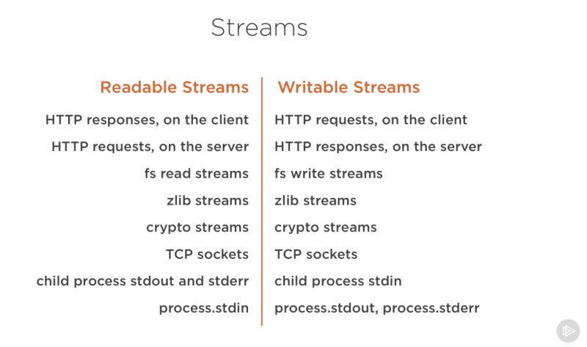
examples for native Node.js objects that are also readable and writable streams

Slide 4
Streams
Some of these objects are both readable and writable streams, like TCP sockets, zlib and crypto streams.
While an HTTP response is a readable stream on the client, it’s a writable stream on the server.
Because in the HTTP case, we basically read from one object (http.IncomingMessage) and write to the other (http.ServerResponse).
Stdio streams (stdin, stdout, stderr) have the inverse stream types when it comes to child processes. This allows for a really easy way to pipe to and from these streams from the main process stdio streams.

Slide 5
Streams
There are four fundamental stream types in Node.js: Readable, Writable, Duplex, and Transform streams.
readable stream is an abstraction for a source from which data can be consumed. An example of that is the fs.createReadStream method.
writable stream is an abstraction for a destination to which data can be written. An example of that is the fs.createWriteStream method.
duplex streams is both Readable and Writable. An example of that is a TCP socket.
A transform stream is basically a duplex stream that can be used to modify or transform the data as it is written and read. An example of that is the zlib.createGzip stream to compress the data using gzip. You can think of a transform stream as a function where the input is the writable stream part and the output is readable stream part

Slide 6
Streams
All streams are instances of EventEmitter.
They emit events that can be used to read and write data.
Can consume streams data in a simpler way using the pipe method.

Slide 7
pipe method
Example: readableSrc.pipe(writableDest)
In this simple example, we’re piping the output of a readable stream — the source of data, as the input of a writable stream — the destination.
The source has to be a readable stream and the destination has to be a writable one.
Can both be duplex/transform streams as well.

Slide 8
Pipe method()
Beside reading from a readable stream source and writing to a writable destination, the pipe method automatically manages a few things along the way.
For example, it handles errors, end-of-files, and the cases when one stream is slower or faster than the other.

Slide 9
Pipe method()
streams can also be consumed with events directly. Here’s the simplified event-equivalent code of what the pipe method mainly does to read and write data:
readable.pipe(writable)
readable.on('data', (chunk) => {
writable.write(chunk);
});
readable.on('end', () => {
writable.end();
});

Slide 10
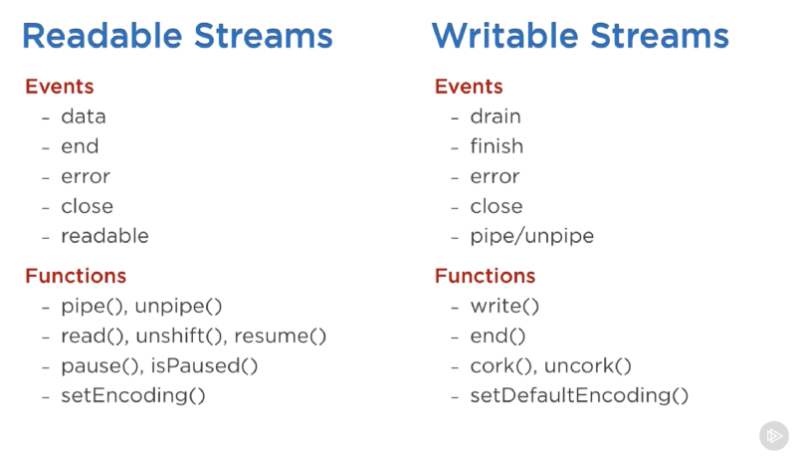
important events and functions that can be used with readable and writable streams:

Slide 11
events on a readable stream are:
The data event, which is emitted whenever the stream passes a chunk of data to the consumer
The end event, which is emitted when there is no more data to be consumed from the stream.

Slide 12
events on a writable stream are:
The drain event, which is a signal that the writable stream can receive more data.
The finish event, which is emitted when all data has been flushed to the underlying system.

